Slide 1
RAC Performance Tuning

Slide 2
Objectives
After completing this lesson, you should be able to:
  Determine RAC-specific tuning components
  Tune instance recovery in RAC
  Determine RAC-specific wait events, global enqueues, and system statistics
  Implement the most common RAC tuning tips
  Use the Cluster Database Performance pages
  Use the Automatic Workload Repository (AWR) in RAC
  Use Automatic Database Diagnostic Monitor (ADDM) in RAC
Notes:
Oracle Database 11g: RAC Administration 6 - <number>

Slide 3
CPU and Wait Time Tuning Dimensions
CPU
time
Possibly
needs SQL
tuning
Scalable
application
Scalable
application
Needs
instance/RAC
tuning
No gain achieved
by adding
CPUs/nodes
Wait
time
Notes:
CPU and Wait Time Tuning Dimensions
When tuning your system, it is important that you compare the CPU time with the wait time of your system. Comparing CPU time with wait time helps to determine how much of the response time is spent on useful work and how much on waiting for resources potentially held by other processes.
As a general rule, the systems where CPU time is dominant usually need less tuning than the ones where wait time is dominant. On the other hand, heavy CPU usage can be caused by badly written SQL statements.
Although the proportion of CPU time to wait time always tends to decrease as load on the system increases, steep increases in wait time are a sign of contention and must be addressed for good scalability.
Adding more CPUs to a node, or nodes to a cluster, would provide very limited benefit under contention. Conversely, a system where the proportion of CPU time does not decrease significantly as load increases can scale better, and would most likely benefit from adding CPUs or Real Application Clusters (RAC) instances if needed.
Note: Automatic Workload Repository (AWR) reports display CPU time together with wait time in the Top 5 Timed Events section, if the CPU time portion is among the top five events.

Slide 4
RAC-Specific Tuning
  Tune for a single instance first.
  Tune for RAC:
    Instance recovery
    Interconnect traffic
    Point of serialization can be exacerbated
  RAC-reactive tuning tools:
    Specific wait events
    System and enqueue statistics
    Enterprise Manager performance pages
    Statspack and AWR reports
  RAC-proactive tuning tools:
    AWR snapshots
    ADDM reports
Certain combinations
are characteristic of
well-known tuning cases.
Notes:
RAC-Specific Tuning
Although there are specific tuning areas for RAC, such as instance recovery and interconnect traffic, you get most benefits by tuning your system like a single-instance system. At least, this must be your starting point.
Obviously, if you have serialization issues in a single-instance environment, these may be exacerbated with RAC.
As shown in the slide, you have basically the same tuning tools with RAC as with a single-instance system. However, certain combinations of specific wait events and statistics are well-known RAC tuning cases.
In this lesson, you see some of those specific combinations, as well as the RAC-specific information that you can get from the Enterprise Manager performance pages, and Statspack and AWR reports. Finally, you see the RAC-specific information that you can get from the Automatic Database Diagnostic Monitor (ADDM).

Slide 5
RAC and Instance or Crash Recovery
Use information
for other caches
Remaster
enqueue
resources
LMS
recovers
GRD
Remaster
cache
resources
1
2
Build
recovery set
SMON
recovers
the
database
Resource
claim
3
Merge failed
redo threads
4
Roll forward
recovery set
5
Recovery time
Notes:
RAC and Instance or Crash Recovery
When an instance fails and the failure is detected by another instance, the second instance performs the following recovery steps:
1. During the first phase of recovery, Global Enqueue Services (GES) remasters the enqueues.
2. The Global Cache Services (GCS) remasters its resources. The GCS processes remaster only those resources that lose their masters. During this time, all GCS resource requests and write requests are temporarily suspended. However, transactions can continue to modify data blocks as long as these transactions have already acquired the necessary resources.
3. After enqueues are reconfigured, one of the surviving instances can grab the Instance Recovery enqueue. Therefore, at the same time as GCS resources are remastered, SMON determines the set of blocks that need recovery. This set is called the recovery set. Because, with Cache Fusion, an instance ships the contents of its blocks to the requesting instance without writing the blocks to the disk, the on-disk version of the blocks may not contain the changes that are made by either instance. This implies that SMON needs to merge the content of all the online redo logs of each failed instance to determine the recovery set. This is because one failed thread might contain a hole in the redo that needs to be applied to a particular block. So, redo threads of failed instances cannot be applied serially. Also, redo threads of surviving instances are not needed for recovery because SMON could use past or current images of their corresponding buffer caches.

Slide 6
Notes only page
Notes:
RAC and Instance or Crash Recovery (continued)
4. Buffer space for recovery is allocated and the resources that were identified in the previous reading of the redo logs are claimed as recovery resources. This is done to avoid other instances to access those resources.
5. All resources required for subsequent processing have been acquired and the Global Resource Directory (GRD) is now unfrozen. Any data blocks that are not in recovery can now be accessed. Note that the system is already partially available.
Then, assuming that there are past images or current images of blocks to be recovered in other caches in the cluster database, the most recent image is the starting point of recovery for these particular blocks. If neither the past image buffers nor the current buffer for a data block is in any of the surviving instances’ caches, then SMON performs a log merge of the failed instances. SMON recovers and writes each block identified in step 3, releasing the recovery resources immediately after block recovery so that more blocks become available as recovery proceeds. Refer to the section “Global Cache Coordination: Example” in this lesson for more information about past images.
After all blocks have been recovered and the recovery resources have been released, the system is again fully available.
In summary, the recovered database or the recovered portions of the database becomes available earlier, and before the completion of the entire recovery sequence. This makes the system available sooner and it makes recovery more scalable.
Note: The performance overhead of a log merge is proportional to the number of failed instances and to the size of the amount of redo written in the redo logs for each instance.

Slide 7
Instance Recovery and Database Availability
Full
A
G
H
5
Database availability
Partial
B
F
2
4
1
2
3
None
C
D
E
Elapsed time
Notes:
Instance Recovery and Database Availability
The graphic illustrates the degree of database availability during each step of Oracle instance recovery:
A. Real Application Clusters is running on multiple nodes.
B. Node failure is detected.
C. The enqueue part of the GRD is reconfigured; resource management is redistributed to the surviving nodes. This operation occurs relatively quickly.
D. The cache part of the GRD is reconfigured and SMON reads the redo log of the failed instance to identify the database blocks that it needs to recover.
E. SMON issues the GRD requests to obtain all the database blocks it needs for recovery. After the requests are complete, all other blocks are accessible.
F. The Oracle server performs roll forward recovery. Redo logs of the failed threads are applied to the database, and blocks are available right after their recovery is completed.
G. The Oracle server performs rollback recovery. Undo blocks are applied to the database for all uncommitted transactions.
H. Instance recovery is complete and all data is accessible.
Note: The dashed line represents the blocks identified in step 2 in the previous slide. Also, the dotted steps represent the ones identified in the previous slide.

Slide 8

Instance Recovery and RAC
Instance startup
+
crash recovery
Instance
crashes
Instance
opens
Instance
starts
FAST_START_MTTR_TARGET
Rolling
forward
ends
Instance
recovery
Instance
crashes
first pass + lock claim
…
FAST_START_MTTR_TARGET
Instance
recovery
starts
V$INSTANCE_RECOVERY.ESTD_CLUSTER_AVAILABLE_TIME
Notes:
Instance Recovery and RAC
In a single-instance environment, the instance startup combined with the crash recovery time is controlled by the setting of the FAST_START_MTTR_TARGET initialization parameter. You can set its value if you want incremental checkpointing to be more aggressive than autotune checkpointing. However, this is at the expense of a much higher I/O overhead.
In a RAC environment, including the startup time of the instance in this calculation is useless because one of the surviving instances is doing the recovery.
In a RAC environment, it is possible to monitor the estimated target (in seconds) for the duration from the start of instance recovery to the time when GCD is open for lock requests for blocks that are not needed for recovery. This estimation is published in the V$INSTANCE_RECOVERY view through the ESTD_CLUSTER_AVAILABLE_TIME column. Basically, you can monitor the time your cluster is frozen during instance recovery situations.
In a RAC environment, the FAST_START_MTTR_TARGET initialization parameter is used to bound the entire instance recovery time, assuming that it is instance recovery for single-instance death.
Note: If you really want to have small instance recovery time by setting FAST_START_MTTR_TARGET, you can safely ignore the alert log messages about raising its value.

Slide 9
Instance Recovery and RAC
  Use parallel instance recovery.
  Increase PARALLEL_EXECUTION_MESSAGE_SIZE.
  Set PARALLEL_MIN_SERVERS.
  Use Async I/O.
  Increase the size of the default buffer cache.
Notes:
Instance Recovery and RAC (continued)
Here are some guidelines you can use to make sure that instance recovery in your RAC environment is faster:
Use parallel instance recovery by setting RECOVERY_PARALLISM.
Increase PARALLEL_EXECUTION_MESSAGE_SIZE from its default of 2,148 bytes to
4 KB or 8 KB. This should provide better recovery slave performance.
Set PARALLEL_MIN_SERVERS to CPU_COUNT-1. This will prespawn recovery slaves at startup time.
Using asynchronous I/O is one of the most crucial factors in recovery time. The first-pass log read uses asynchronous I/O.
Instance recovery uses 50 percent of the default buffer cache for recovery buffers. If this is not enough, some of the steps of instance recovery will be done in several passes. You should be able to identify such situations by looking at your alert.log file. In that case, you should increase the size of your default buffer cache.

Slide 10
Analyzing Cache Fusion Impact in RAC
  The cost of block access and cache coherency is represented by:
    Global Cache Services statistics
    Global Cache Services wait events
  The response time for Cache Fusion transfers is determined by:
    Overhead of the physical interconnect components
    IPC protocol
    GCS protocol
  The response time is not generally affected by disk I/O factors.
Notes:
Analyzing Cache Fusion Impact in RAC
The effect of accessing blocks in the global cache and maintaining cache coherency is represented by:
The Global Cache Services statistics for current and cr blocks; for example, gc current blocks received, gc cr blocks received, and so on.
The Global Cache Services wait events for gc current block 3-way, gc cr grant 2-way, and so on.
The response time for Cache Fusion transfers is determined by the messaging time and processing time imposed by the physical interconnect components, the IPC protocol, and the GCS protocol. It is not affected by disk input/output (I/O) factors other than occasional log writes. The Cache Fusion protocol does not require I/O to data files in order to guarantee cache coherency, and RAC inherently does not cause any more I/O to disk than a nonclustered instance.

Slide 11
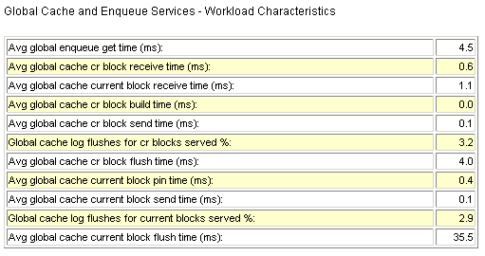
Typical Latencies for RAC Operations
AWR Report Latency Name | Lower Bound | Typical | Upper Bound
Average time to process cr block request | 0.1 | 1 | 10
Avg global cache cr block receive time (ms) | 0.3 | 4 | 12
Average time to process current block request | 0.1 | 3 | 23
Avg global cache current block receive time(ms) | 0.3 | 8 | 30
Notes:
Typical Latencies for RAC Operations
In a RAC AWR report, there is a table in the RAC Statistics section containing average times (latencies) for some Global Cache Services and Global Enqueue Services operations. This table is shown in the slide and is called “Global Cache and Enqueue Services: Workload Characteristics.” Those latencies should be monitored over time, and significant increases in their values should be investigated. The table presents some typical values, based on empirical observations. Factors that may cause variations to those latencies include:
Utilization of the IPC protocol. User-mode IPC protocols are faster, but only Tru64’s RDG is recommended for use.
Scheduling delays, when the system is under high CPU utilization
Log flushes for current blocks served
Other RAC latencies in AWR reports are mostly derived from V$GES_STATISTICS and may be useful for debugging purposes, but do not require frequent monitoring.
Note: The time to process consistent read (CR) block request in the cache corresponds to (build time + flush time + send time), and the time to process current block request in the cache corresponds to (pin time + flush time + send time).

Slide 12

Wait Events for RAC
  Wait events help to analyze what sessions are waiting for.
  Wait times are attributed to events that reflect the outcome of a request:
    Placeholders while waiting
    Precise events after waiting
  Global cache waits are summarized in a broader category called Cluster Wait Class.
  These wait events are used in ADDM to enable Cache Fusion diagnostics.
Notes:
Wait Events for RAC
Analyzing what sessions are waiting for is an important method to determine where time is spent. In RAC, the wait time is attributed to an event that reflects the exact outcome of a request. For example, when a session on an instance is looking for a block in the global cache, it does not know whether it will receive the data cached by another instance or whether it will receive a message to read from disk. The wait events for the global cache convey precise information and wait for global cache blocks or messages. They are mainly categorized by the following:
Summarized in a broader category called Cluster Wait Class
Temporarily represented by a placeholder event that is active while waiting for a block
Attributed to precise events when the outcome of the request is known
The wait events for RAC convey information valuable for performance analysis. They are used in ADDM to enable precise diagnostics of the impact of Cache Fusion.

Slide 13
Wait Event Views
Total waits for an event
V$SYSTEM_EVENT
Waits for a wait event class
by a session
V$SESSION_WAIT_CLASS
Waits for an event by a session
V$SESSION_EVENT
Activity of recent active sessions
V$ACTIVE_SESSION_HISTORY
Last 10 wait events
for each active session
V$SESSION_WAIT_HISTORY
Events for which
active sessions are waiting
V$SESSION_WAIT
Identify SQL statements impacted
by interconnect latencies
V$SQLSTATS
Notes:
Wait Event Views
When it takes some time to acquire resources because of the total path length and latency for requests, processes sleep to avoid spinning for indeterminate periods of time. When the process decides to wait, it wakes up either after a specified timer value expires (timeout) or when the event it is waiting for occurs and the process is posted. The wait events are recorded and aggregated in the views shown in the slide. The first three are aggregations of wait times, timeouts, and the number of times waited for a particular event, whereas the rest enable the monitoring of waiting sessions in real time, including a history of recent events waited for.
The individual events distinguish themselves by their names and the parameters that they assume. For most of the global cache wait events, the parameters include file number, block number, the block class, and access mode dispositions, such as mode held and requested. The wait times for events presented and aggregated in these views are very useful when debugging response time performance issues. Note that the time waited is cumulative, and that the event with the highest score is not necessarily a problem. However, if the available CPU power cannot be maximized, or response times for an application are too high, the top wait events provide valuable performance diagnostics.
Note: Use the CLUSTER_WAIT_TIME column in V$SQLSTATS to identify SQL statements impacted by interconnect latencies, or run an ADDM report on the corresponding AWR snapshot.

Slide 14
Global Cache Wait Events: Overview
Just requested
(placeholder)
gc [current/cr] [multiblock] request
gc [current/cr] [2/3]-way
gc [current/cr] block busy
Received after two or three network hops, immediately after request
Received but not sent immediately
gc [current/cr] grant 2-way
gc current grant busy
Not received and not mastered locally. Grant received immediately.
Not received and not mastered locally. Grant received with delay.
gc [current/cr] [block/grant] congested
gc [current/cr] [failure/retry]
Block or grant received with delay because of CPU or memory lack
Not received because of failure
gc buffer busy
Block arrival time
less than buffer pin time
Notes:
Global Cache Wait Events: Overview
The main global cache wait events for Oracle Database 10g are described briefly in the slide:
gc current/cr request: These wait events are relevant only while a gc request for a cr or current buffer is in progress. They act as placeholders until the request completes.
gc [current/cr] [2/3]-way: A current or cr block is requested and received after two or three network hops. The request is processed immediately: the block is not busy or congested.
gc [current/cr] block busy: A current or cr block is requested and received, but is not sent immediately by LMS because some special condition that delayed the sending was found.
gc [current/cr] grant 2-way: A current or cr block is requested and a grant message received. The grant is given without any significant delays. If the block is not in its local cache, a current or cr grant is followed by a disk read on the requesting instance.
gc current grant busy: A current block is requested and a grant message received. The busy hint implies that the request is blocked because others are ahead of it or it cannot be handled immediately.
Note: For dynamic remastering, two events are of the most practical importance: gc remaster and gc quiesce. They can be symptoms of the effect of remastering on the running processes.

Slide 15
Notes only page
Notes:
Global Cache Wait Events: Overview (continued)
gc [current/cr] [block/grant] congested: A current or cr block is requested and a block or grant message received. The congested hint implies that the request spent more than 1 ms in internal queues.
gc [current/cr] [failure/retry]: A block is requested and a failure status received or some other exceptional event has occurred.
gc buffer busy: If the time between buffer accesses becomes less than the time the buffer is pinned in memory, the buffer containing a block is said to become busy and as a result interested users may have to wait for it to be unpinned.
Note: For more information, refer to the Oracle Database Reference guide.

Slide 16
2-way Block Request: Example
Wait:
gc current block request
1
FGP
Direct send
SGA2
2
LGWR:
Log sync
LGWR
SGA1
Block transfer
Wait complete:
gc current block 2-way
LMS
3
Notes:
2-way Block Request: Example
This slide shows you what typically happens when the master instance requests a block that is not cached locally. Here it is supposed that the master instance is called SGA1, and SGA2 contains the requested block. The scenario is as follows:
1. SGA1 sends a direct request to SGA2. So SGA1 waits on the gc current block request event.
2. When SGA2 receives the request, its local LGWR process may need to flush some recovery information to its local redo log files. For example, if the cached block is frequently changed, and the changes have not been logged yet, LMS would have to ask LGWR to flush the log before it can ship the block. This may add a delay to the serving of the block and may show up in the requesting node as a busy wait.
3. Then, SGA2 sends the requested block to SGA1. When the block arrives in SGA1, the wait event is complete, and is reflected as gc current block 2-way.
Note: Using the notation R = time at requestor, W = wire time and transfer delay, and S = time at server, the total time for a round-trip would be:
R(send) + W(small msg) + S(process msg,process block,send) + W(block) + R(receive block)

Slide 17
3-way Block Request: Example
Wait:
gc current block request
1
LMS
Resource
Master
2
FGP
Direct
message
SGA2
3
LGWR
SGA1
Block transfer
LMS
Wait complete:
gc current block 3-way
4
Notes:
3-way Block Request: Example
This is a modified scenario for a cluster with more than two nodes. It is very similar to the previous one. However, the master for this block is on a node that is different from that of the requestor, and where the block is cached. Thus, the request must be forwarded. There is an additional delay for one message and the processing at the master node:
R(send) + W(small msg) + S(process msg,send) + W(small msg) + S(process msg,process block,send) + W(block) + R(receive block)
While a remote read is pending, any process on the requesting instance that is trying to write or read the data cached in the buffer has to wait for a gc buffer busy. The buffer remains globally busy until the block arrives.

Slide 18
2-way Grant: Example
Wait:
gc current block request
1
LMS
Resource
Master
FGP
Direct
message
SGA2
2
SGA1
3
Grant message
Wait complete:
gc current grant 2-way
Notes:
2-way Grant: Example
In this scenario, a grant message is sent by the master because the requested block is not cached in any instance.
If the local instance is the resource master, the grant happens immediately. If not, the grant is always 2-way, regardless of the number of instances in the cluster.
The grant messages are small. For every block read from the disk, a grant has to be received before the I/O is initiated, which adds the latency of the grant round-trip to the disk latency:
R(send) + W(small msg) + S(process msg,send) + W(small msg) + R(receive block)
The round-trip looks similar to a 2-way block round-trip, with the difference that the wire time is determined by a small message, and the processing does not involve the buffer cache.

Slide 19
Global Enqueue Waits: Overview
  Enqueues are synchronous.
  Enqueues are global resources in RAC.
  The most frequent waits are for:
  The waits may constitute serious serialization points.
TX
TM
US
HW
TA
SQ
Notes:
Global Enqueue Waits: Overview
An enqueue wait is not RAC specific, but involves a global lock operation when RAC is enabled. Most of the global requests for enqueues are synchronous, and foreground processes wait for them. Therefore, contention on enqueues in RAC is more visible than in single-instance environments. Most waits for enqueues occur for enqueues of the following types:
TX: Transaction enqueue; used for transaction demarcation and tracking
TM: Table or partition enqueue; used to protect table definitions during DML operations
HW: High-water mark enqueue; acquired to synchronize a new block operation
SQ: Sequence enqueue; used to serialize incrementing of an Oracle sequence number
US: Undo segment enqueue; mainly used by the Automatic Undo Management (AUM) feature
TA: Enqueue used mainly for transaction recovery as part of instance recovery
In all of the cases above, the waits are synchronous and may constitute serious serialization points that can be exacerbated in a RAC environment.
Note: In Oracle Database 10g, the enqueue wait events specify the resource name and a reason for the wait—for example, TX Enqueue index block split. This makes diagnostics of enqueue waits easier.

Slide 20
Session and System Statistics
  Use V$SYSSTAT to characterize the workload.
  Use V$SESSTAT to monitor important sessions.
  V$SEGMENT_STATISTICS includes RAC statistics.
  RAC-relevant statistic groups are:
    Global Cache Service statistics
    Global Enqueue Service statistics
    Statistics for messages sent
  V$ENQUEUE_STATISTICS determines the enqueue with the highest impact.
  V$INSTANCE_CACHE_TRANSFER breaks down GCS statistics into block classes.
Notes:
Session and System Statistics
Using system statistics based on V$SYSSTAT enables characterization of the database activity based on averages. It is the basis for many metrics and ratios used in various tools and methods, such as AWR, Statspack, and Database Control.
In order to drill down to individual sessions or groups of sessions, V$SESSTAT is useful when the important session identifiers to monitor are known. Its usefulness is enhanced if an application fills in the MODULE and ACTION columns in V$SESSION.
V$SEGMENT_STATISTICS is useful for RAC because it also tracks the number of CR and current blocks received by the object.
The RAC-relevant statistics can be grouped into:
Global Cache Service statistics: gc cr blocks received, gc cr block receive time, and so on
Global Enqueue Service statistics: global enqueue gets and so on
Statistics for messages sent: gcs messages sent and ges messages sent
V$ENQUEUE_STATISTICS can be queried to determine which enqueue has the highest impact on database service times and eventually response times.
V$INSTANCE_CACHE_TRANSFER indicates how many current and CR blocks per block class are received from each instance, including how many transfers incurred a delay.
Note: For more information about statistics, refer to the Oracle Database Reference guide.

Slide 21
Most Common RAC Tuning Tips
  Application tuning is often the most beneficial.
  Resizing and tuning the buffer cache
  Reducing long full-table scans in OLTP systems
  Using Automatic Segment Space Management
  Increasing sequence caches
  Using partitioning to reduce interinstance traffic
  Avoiding unnecessary parsing
  Minimizing locking usage
  Removing unselective indexes
  Configuring interconnect properly
Notes:
Most Common RAC Tuning Tips
In any database system, RAC or single instance, the most significant performance gains are usually obtained from traditional application-tuning techniques. The benefits of those techniques are even more remarkable in a RAC database. In addition to traditional application tuning, some of the techniques that are particularly important for RAC include the following:
Try to avoid long full-table scans to minimize GCS requests. The overhead caused by the global CR requests in this scenario is because of the fact that when queries result in local cache misses, an attempt is first made to find the data in another cache, based on the assumption that the chance that another instance has cached the block is high.
Automatic Segment Space Management can provide instance affinity to table blocks.
Increasing sequence caches improves instance affinity to index keys deriving their values from sequences. That technique may result in significant performance gains for multiinstance insert-intensive applications.
Range or list partitioning may be very effective in conjunction with data-dependent routing, if the workload can be directed to modify a particular range of values from a particular instance.
Hash partitioning may help to reduce buffer busy contention by making buffer access distribution patterns sparser, enabling more buffers to be available for concurrent access.

Slide 22
Notes only page
Notes:
Most Common RAC Tuning Tips (continued)
In RAC, library cache and row cache operations are globally coordinated. So, excessive parsing means additional interconnect traffic. Library cache locks are heavily used, in particular by applications using PL/SQL or Advanced Queuing. Library cache locks are acquired in exclusive mode whenever a package or procedure has to be recompiled.
Because transaction locks are globally coordinated, they also deserve special attention in RAC. For example, using tables instead of Oracle sequences to generate unique numbers is not recommended because it may cause severe contention even for a single instance system.
Indexes that are not selective do not improve query performance, but can degrade DML performance. In RAC, unselective index blocks may be subject to interinstance contention, increasing the frequency of cache transfers for indexes belonging to INSERT-intensive tables.
Always verify that you use a private network for your interconnect, and that your private network is configured properly. Ensure that a network link is operating in full duplex mode. Ensure that your network interface and Ethernet switches support MTU size of 9 KB. Note that a single GBE can scale up to ten thousand 8-KB blocks per second before saturation.

Slide 23
Index Block Contention: Considerations
Wait events
enq: TX - index contention
gc buffer busy
gc current block busy
gc current split
Index
block
Split in
progress
System statistics
Leaf node splits
Branch node splits
Exchange deadlocks
gcs refuse xid gcs ast xid
Service ITL waits
RAC01
RAC02
Notes:
Index Block Contention: Considerations
In application systems where the loading or batch processing of data is a dominant business function, there may be performance issues affecting response times because of the high volume of data inserted into indexes. Depending on the access frequency and the number of processes concurrently inserting data, indexes can become hot spots and contention can be exacerbated by:
Ordered, monotonically increasing key values in the index (right-growing trees)
Frequent leaf block splits
Low tree depth: All leaf block access go through the root block.
A leaf or branch block split can become an important serialization point if the particular leaf block or branch of the tree is concurrently accessed.
The tables in the slide sum up the most common symptoms associated with the splitting of index blocks, listing wait events and statistics that are commonly elevated when index block splits are prevalent. As a general recommendation, to alleviate the performance impact of globally hot index blocks and leaf block splits, a more uniform, less skewed distribution of the concurrency in the index tree should be the primary objective. This can be achieved by:
Global index hash partitioning
Increasing the sequence cache, if the key value is derived from a sequence
Use natural keys as opposed to surrogate keys
Use reverse key indexes

Slide 24
Oracle Sequences and Index Contention
Can contain 500 rows
…
1…50000
50001…100000
CACHE 50000 NOORDER
RAC01
RAC02
Notes:
Oracle Sequences and Index Contention
Indexes with key values generated by sequences tend to be subject to leaf block contention when the insert rate is high. That is because the index leaf block holding the highest key value is changed for every row inserted, as the values are monotonically ascending. In RAC, this may lead to a high rate of current and CR blocks transferred between nodes.
One of the simplest techniques that can be used to limit this overhead is to increase the sequence cache, if you are using Oracle sequences. As the difference between sequence values generated by different instances increases, successive index block splits tend to create instance affinity to index leaf blocks. For example, suppose that an index key value is generated by a CACHE NOORDER sequence and each index leaf block can hold 500 rows. If the sequence cache is set to 50000, while instance 1 inserts values 1, 2, 3, and so on, instance 2 concurrently inserts 50001, 50002, and so on. After some block splits, each instance writes to a different part of the index tree.
So, what is the ideal value for a sequence cache to avoid interinstance leaf index block contention, yet minimizing possible gaps? One of the main variables to consider is the insert rate: the higher it is, the higher must be the sequence cache. However, creating a simulation to evaluate the gains for a specific configuration is recommended.
Note: By default, the cache value is 20. Typically, 20 is too small for the example above.

Slide 25
Undo Block Considerations
Index
Changes
Reads
…
SGA1
SGA2
Undo
Undo
Additional
interconnect traffic
Notes:
Undo Block Considerations
Excessive undo block shipment and contention for undo buffers usually happens when index blocks containing active transactions from multiple instances are read frequently.
When a SELECT statement needs to read a block with active transactions, it has to undo the changes to create a CR version. If the active transactions in the block belong to more than one instance, there is a need to combine local and remote undo information for the consistent read. Depending on the amount of index blocks changed by multiple instances and the duration of the transactions, undo block shipment may become a bottleneck.
Usually this happens in applications that read recently inserted data very frequently, but commit infrequently. Techniques that can be used to reduce such situations include the following:
Shorter transactions reduce the likelihood that any given index block in the cache contains uncommitted data, thereby reducing the need to access undo information for consistent read.
As explained earlier, increasing sequence cache sizes can reduce interinstance concurrent access to index leaf blocks. CR versions of index blocks modified by only one instance can be fabricated without the need of remote undo information.
Note: In RAC, the problem is exacerbated by the fact that a subset of the undo information has to be obtained from remote instances.

Slide 26
High-Water Mark Considerations
Wait events
enq: HW - contention
gc current grant
Heavy
inserts
HWM
Heavy
inserts
New extent
RAC01
RAC02
Notes:
High-Water Mark Considerations
A certain combination of wait events and statistics presents itself in applications where the insertion of data is a dominant business function and new blocks have to be allocated frequently to a segment. If data is inserted at a high rate, new blocks may have to be made available after unfruitful searches for free space. This has to happen while holding the high-water mark (HWM) enqueue.
Therefore, the most common symptoms for this scenario include:
A high percentage of wait time for enq: HW – contention
A high percentage of wait time for gc current grant events
The former is a consequence of the serialization on the HWM enqueue, and the latter is because of the fact that current access to the new data blocks that need formatting is required for the new block operation. In a RAC environment, the length of this space management operation is proportional to the time it takes to acquire the HWM enqueue and the time it takes to acquire global locks for all the new blocks that need formatting. This time is small under normal circumstances because there is never any access conflict for the new blocks. Therefore, this scenario may be observed in applications with business functions requiring a lot of data loading, and the main recommendation to alleviate the symptoms is to define uniform and large extent sizes for the locally managed and automatic space managed segments that are subject to high-volume inserts.

Slide 27
Concurrent Cross-Instance Calls: Considerations
Dirty
block
SGA1
SGA2
Table1
Table1
CKPT
CKPT
Table2
Table2
1
2
3
4
Truncate Table1
Truncate Table2
Cross-instance call
Notes:
Concurrent Cross-Instance Calls: Considerations
In data warehouse and data mart environments, it is not uncommon to see a lot of TRUNCATE operations. These essentially happen on tables containing temporary data.
In a RAC environment, truncating tables concurrently from different instances does not scale well, especially if, in conjunction, you are also using direct read operations such as parallel queries.
As shown in the slide, a truncate operation requires a cross-instance call to flush dirty blocks of the table that may be spread across instances. This constitutes a point of serialization. So, while the first TRUNCATE command is processing, the second has to wait until the first one completes.
There are different types of cross-instance calls. However, all use the same serialization mechanism.
For example, the cache flush for a partitioned table with many partitions may add latency to a corresponding parallel query. This is because each cross-instance call is serialized at the cluster level, and one cross-instance call is needed for each partition at the start of the parallel query for direct read purposes.

Slide 28
Monitoring RAC Database and Cluster Performance
Database
Directly from Database Control and Grid Control:
  Status of each node in the cluster
  Aggregated alert messages across all the instances
  Review issues that are affecting the entire cluster or each instance
  Monitor cluster cache coherency statistics
  Determine if any of the services for the cluster database are having availability problems
  Review any outstanding Clusterware interconnect alerts
Instances
Notes:
Monitoring RAC Database and Cluster Performance
Both Oracle Enterprise Manager Database Control and Grid Control are cluster-aware and provide a central console to manage your cluster database. From the Cluster Database Home page, you can do the following:
View the overall system status, such as the number of nodes in the cluster and their current status so that you do not have to access each individual database instance for details
View alert messages aggregated across all the instances with lists for the source of each alert message
Review issues that are affecting the entire cluster as well as those that are affecting individual instances
Monitor cluster cache coherency statistics to help you identify processing trends and optimize performance for your Oracle RAC environment. Cache coherency statistics measure how well the data in caches on multiple instances is synchronized.
Determine if any of the services for the cluster database are having availability problems. A service is determined to be a problem service if it is not running on all preferred instances, if its response time thresholds are not met, and so on.
Review any outstanding Clusterware interconnect alerts

Slide 29
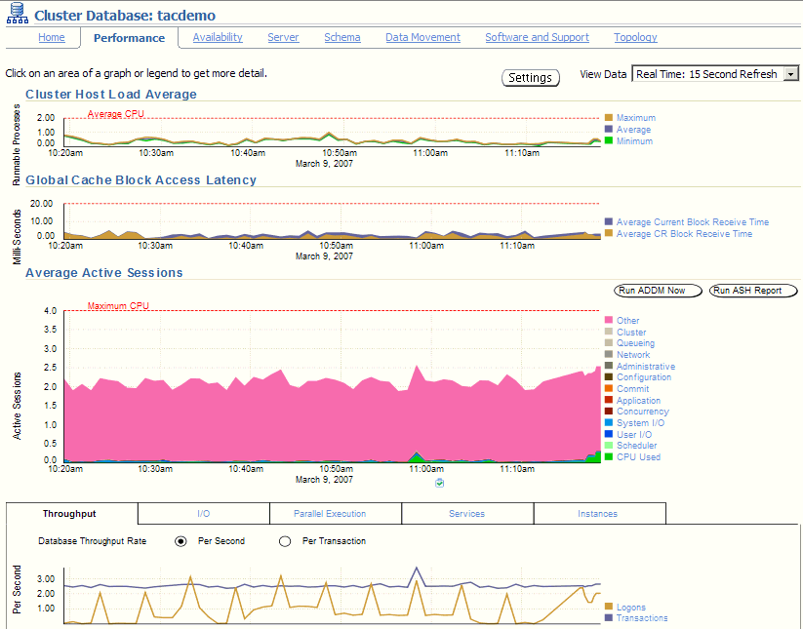
Cluster Database Performance Page
Notes:
Cluster Database Performance Page
The Cluster Database Performance page provides a quick glimpse of the performance statistics for a database. Enterprise Manager accumulates data from each instance over specified periods of time (known as collection-based data). Enterprise Manager also provides current data from each instance (known as real-time data).
Statistics are rolled up across all the instances in the cluster database. Using the links next to the charts, you can get more specific information and perform any of the following tasks:
Identify the causes of performance issues.
Decide whether resources need to be added or redistributed.
Tune your SQL plan and schema for better optimization.
Resolve performance issues.
The screenshot shows a partial view of the Cluster Database Performance page. You access this page by clicking the Performance tab on the Cluster Database Home page.

Slide 30
Determining Cluster Host Load Average
Notes:
Determining Cluster Host Load Average
The Cluster Host Load Average chart on the Cluster Database Performance page shows potential problems that are outside the database. The chart shows maximum, average, and minimum load values for available nodes in the cluster for the previous hour.
If the load average is higher than the average of the total number of CPUs across all the hosts in the cluster, then too many processes are waiting for CPU resources. SQL statements that are not tuned often cause high CPU usage. Compare the load average values with the values displayed for CPU Used in the Average Active Sessions chart. If the sessions value is low and the load average value is high, something else on the host—other than your database—is consuming the CPU.
You can click any of the load value labels for the Cluster Host Load Average chart to view more detailed information about that load value. For example, if you click the label Average, the Hosts: Average Load page appears, displaying charts that depict the average host load for up to four nodes in the cluster.
You can select whether the data is displayed in a summary chart (combining the data for each node in one display) or in tile charts (where the data for each node is displayed in its own chart). You can click Customize to change the number of tile charts displayed in each row or the method of ordering the tile charts.

Slide 31
Determining Global Cache Block Access Latency
Notes:
Determining Global Cache Block Access Latency
The Global Cache Block Access Latency chart shows the latency for each different type of data block requests: current and consistent-read (CR) blocks. That is the elapsed time it takes to locate and transfer consistent-read and current blocks between the buffer caches.
You can click either metric for the Global Cache Block Access Latency chart to view more detailed information about that type of cached block.
If the Global Cache Block Access Latency chart shows high latencies (high elapsed times), the cause can be any of the following:
A high number of requests caused by SQL statements that are not tuned
A large number of processes in the queue waiting for the CPU, or scheduling delays
Slow, busy, or faulty interconnects. In these cases, check your network connection for dropped packets, retransmittals, or cyclic redundancy check (CRC) errors.
Concurrent read and write activity on shared data in a cluster is a frequently occurring activity. Depending on the service requirements, this activity does not usually cause performance problems. However, when global cache requests cause a performance problem, optimizing SQL plans and the schema to improve the rate at which data blocks are located in the local buffer cache, and minimizing I/O is a successful strategy for performance tuning. If the latency for consistent-read and current block requests reaches 10 milliseconds, the first step in resolving the problem should be to go to the Cluster Cache Coherency page for more detailed information.

Slide 32
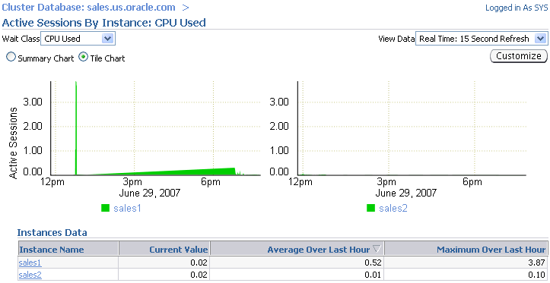
Determining Average Active Sessions
Notes:
Determining Average Active Sessions
The Average Active Sessions chart in the Cluster Database Performance page shows potential problems inside the database. Categories, called wait classes, show how much of the database is using a resource, such as CPU or disk I/O. Comparing CPU time to wait time helps determine how much of the response time is consumed with useful work rather than waiting for resources that are potentially held by other processes.
At the cluster database level, this chart shows the aggregate wait class statistics across all the instances. For a more detailed analysis, click the clipboard icon at the bottom of the chart to view the ADDM analysis for the database for that time period.
If you click the wait class legends beside the Average Active Sessions chart, you can view instance-level information stored in “Active Sessions by Instance” pages. Use the Wait Class action list on the “Active Sessions by Instance” page to view the different wait classes. The “Active Sessions by Instance” pages show the service times for up to four instances. Using the Customize button, you can select the instances that are displayed. You can view the data for the instances separately using tile charts, or you can combine the data into a single summary chart.

Slide 33
Determining Database Throughput
Notes:
Determining Database Throughput
The last chart on the Performance page monitors the usage of various database resources. By clicking the Throughput tab at the top of this chart, you can view the Database Throughput chart. Compare the peaks on the Average Active Sessions chart with those on the Database Throughput charts. If internal contention is high and throughput is low, consider tuning the database.
The Database Throughput charts summarize any resource contention that appears in the Average Active Sessions chart, and also show how much work the database is performing on behalf of the users or applications. The Per Second view shows the number of transactions compared to the number of logons, and (not shown here) the amount of physical reads compared to the redo size per second. The Per Transaction view shows the amount of physical reads compared to the redo size per transaction. Logons is the number of users that are logged on to the database.
You can also obtain information at the instance level by clicking one of the legends to the right of the charts to access the “Database Throughput by Instance” page. This page shows the breakdown of the aggregated Database Throughput chart for up to four instances. You can select the instances that are displayed. You can drill down further on the “Database Throughput by Instance” page to see the sessions of an instance that is consuming the greatest resources. Click an instance name legend just under the chart to go to the Top Sessions subpage of the Top Consumers page for that instance.

Slide 34
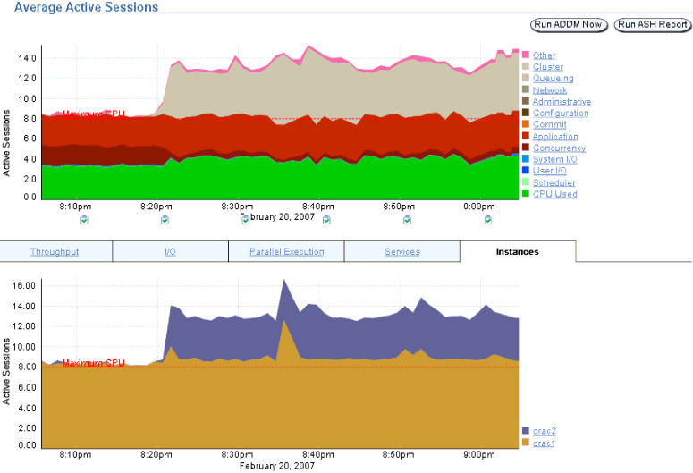
Determining Database Throughput
Notes:
Determining Database Throughput (continued)
The last chart on the Performance page monitors the usage of various database resources. By clicking the Instances tab at the top of this chart, you can view the “Active Sessions by Instance” chart, which summarizes any resource contention that appears in the Average Active Sessions chart. You can thus quickly determine how much of the database work is being performed on each instance.
You can also obtain information at the instance level by clicking one of the legends to the right of the chart to access the Top Sessions page, where you can view real-time data showing the sessions that consume the greatest system resources. In the graph in the slide, the orac2 instance after 8:20 PM consistently shows more active sessions than the orac1 instance.

Slide 35
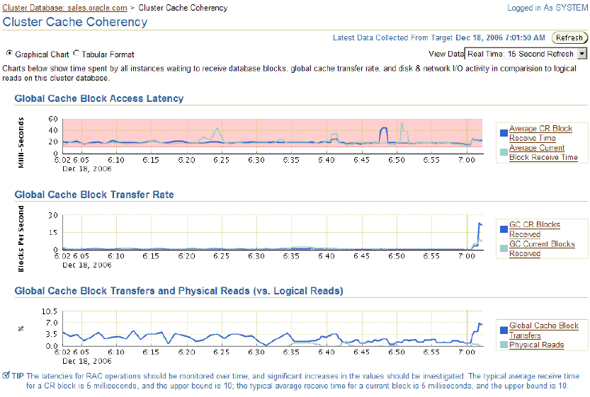
Accessing the Cluster Cache Coherency Page
Block
Class
Segment
name
Segment
name
Notes:
Accessing the Cluster Cache Coherency Page
To access the Cluster Cache Coherency page, click the Performance tab on the Cluster Database Home page, and click Cluster Cache Coherency in the Additional Monitoring Links section at the bottom of the page. Alternatively, click either of the legends to the right of the Global Cache Block Access Latency chart.
The Cluster Cache Coherency page contains summary charts for cache coherency metrics for the cluster:
Global Cache Block Access Latency: Shows the total elapsed time, or latency, for a block request. Click one of the legends to the right of the chart to view the average time it takes to receive data blocks for each block type (current or CR) by instance. On the “Average Block Receive Time by Instance” page, you can click an instance legend under the chart to go to the “Block Transfer for Local Instance” page, where you can identify which block classes (such as undo blocks, data blocks, and so on) are subject to intense global cache activity. This page displays the block classes that are being transferred and the instances that are transferring most of the blocks. Cache transfer indicates how many current and CR blocks for each block class were received from remote instances, including how many transfers incurred a delay (busy) or an unexpected longer delay (congested).

Slide 36
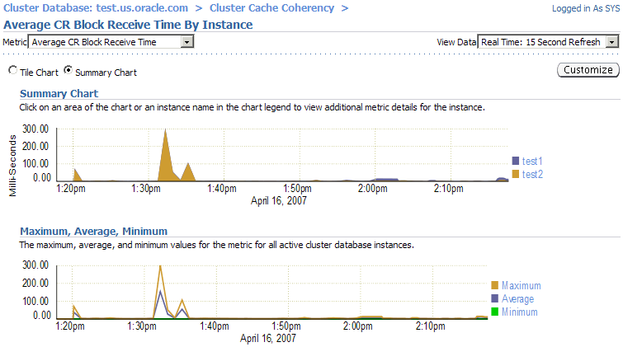
Accessing the Cluster Cache Coherency Page
Notes:
Accessing the Cluster Cache Coherency Page (continued)
Global Cache Block Transfer Rate: Shows the total aggregated number of blocks received by all instances in the cluster by way of an interconnect. Click one of the legends to the right of the chart to go to the “Global Cache Blocks Received by Instance” page for that type of block. From there, you can click an instance legend under the chart to go to the “Segment Statistics by Instance” page, where you can see which segments are causing cache contention.
Global Cache Block Transfers and Physical Reads: Shows the percentage of logical read operations that retrieved data from the buffer cache of other instances by way of Direct Memory Access and from disk. It is essentially a profile of how much work is performed in the local buffer cache rather than the portion of remote references and physical reads (which both have higher latencies). Click one of the legends to the right of the chart to go to the “Global Cache Block Transfers vs. Logical Reads by Instance” and “Physical Reads vs. Logical Reads by Instance” pages. From there, you can click an instance legend under the chart to go to the “Segment Statistics by Instance” page, where you can see which segments are causing cache contention.

Slide 37
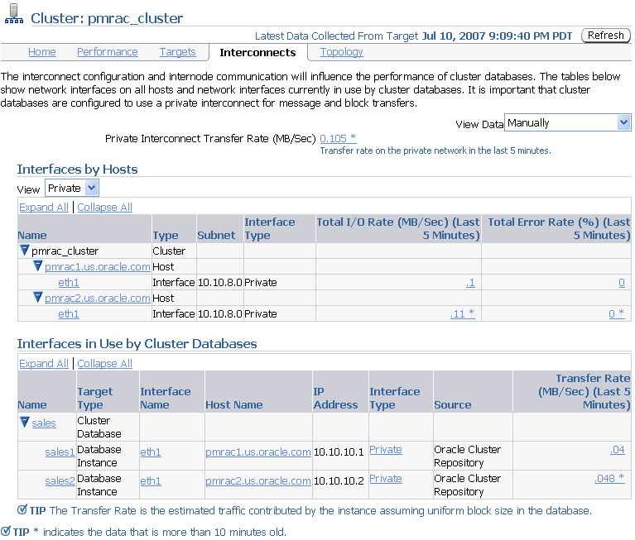
Viewing Cluster Interconnects Page
Notes:
Viewing Cluster Interconnects Page
The Cluster Interconnects page is useful for monitoring the interconnect interfaces, determining configuration issues, and identifying transfer rate-related issues, including excess traffic. This page helps determine the load added by individual instances and databases on the interconnect. Sometimes you can immediately identify interconnect delays that are due to applications outside Oracle.
You can use this page to perform the following tasks:
Viewing all interfaces that are configured across the cluster
Viewing statistics for the interfaces, such as absolute transfer rates and errors
Determining the type of interfaces, such as private or public
Determining whether the instance is using a public or private network
Determining which database instance is currently using which interface
Determining how much the instance is contributing to the transfer rate on the interface
The Private Interconnect Transfer Rate value shows a global view of the private interconnect traffic, which is the estimated traffic on all the private networks in the cluster. The traffic is calculated as the summary of the input rate of all private interfaces that are known to the cluster.

Slide 38
Notes:
Viewing Cluster Interconnects Page (continued)
On the Cluster Interconnects page, you can access the Hardware Details page, where you obtain more information about all the network interfaces defined on each node of your cluster.
Similarly, you can access the Transfer Rate metric page, which collects the internode communication traffic of a cluster database instance. The critical and warning thresholds of this metric are not set by default. You can set them according to the speed of your cluster interconnects.
Note: You can query the V$CLUSTER_INTERCONNECTS view to see information about the private interconnect.

Slide 39
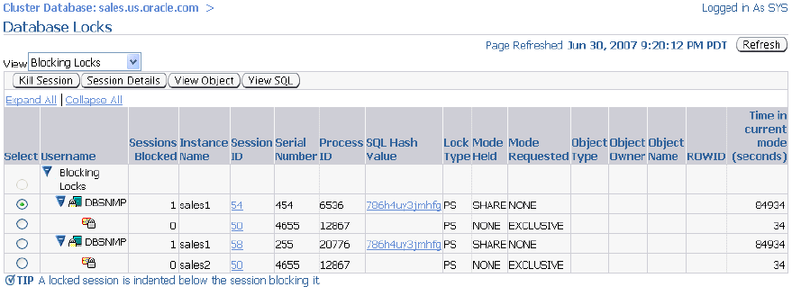
Viewing the Database Locks Page
Notes:
Viewing the Database Locks Page
Use the Database Locks page to determine if multiple instances are holding locks for the same object. The page shows user locks, all database locks, or locks that are blocking other users or applications. You can use this information to stop a session that is unnecessarily locking an object.
To access the Database Locks page, select Performance on the Cluster Database Home page, and click Database Locks in the Additional Monitoring Links section at the bottom of the Performance subpage.

Slide 40


AWR Snapshots in RAC
MMON Coordinator
In-memory
statistics
SYSAUX
SGA (Inst1)
AWR tables
…
6:00 a.m.
9:00 a.m.
7:00 a.m.
8:00 a.m.
MMON
9:00 a.m.
In-memory
statistics
SGA (Instn)
Notes:
AWR Snapshots in RAC
In RAC environments, each AWR snapshot captures data from all active instances within the cluster. The data for each snapshot set that is captured for all active instances is from roughly the same point in time. In addition, the data for each instance is stored separately and is identified with an instance identifier. For example, the buffer_busy_wait statistic shows the number of buffer waits on each instance. The AWR does not store data that is aggregated from across the entire cluster. That is, the data is stored for each individual instance.
The statistics snapshots generated by the AWR can be evaluated by producing reports displaying summary data such as load and cluster profiles based on regular statistics and wait events gathered on each instance.
The AWR functions in a similar way as Statspack. The difference is that the AWR automatically collects and maintains performance statistics for problem detection and self-tuning purposes. Unlike in Statspack, in the AWR there is only one snapshot_id per snapshot across instances.

Slide 41
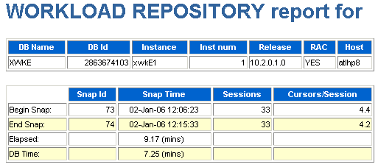


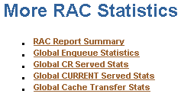
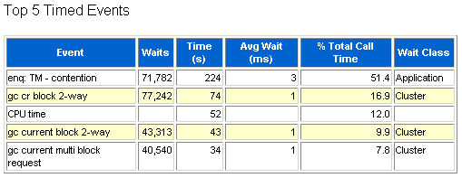
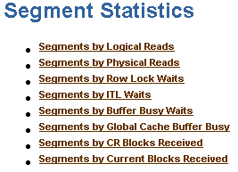
AWR Reports and RAC: Overview
Notes:
AWR Reports and RAC: Overview
The RAC-related statistics in an AWR report are organized in different sections. A RAC statistics section appears after the Top 5 Timed Events. This section contains:
The number of instances open at the time of the begin snapshot and the end snapshot to indicate whether instances joined or left between the two snapshots
Global Cache Load Profile: Essentially lists the number of blocks and messages that are sent and received, as well as the number of fusion writes
Global Cache Efficiency Percentages: Indicate the percentage of buffer is divided into buffers received from the disk, local cache, and remote caches. Ideally, the percentage of disk buffer access should be close to zero.
GCS and GES Workload Characteristics: Gives you an overview of the more important numbers first. Because the global enqueue convert statistics have been consolidated with the global enqueue get statistics, the report prints only the average global enqueue get time. The round-trip times for CR and current block transfers follow, as well as the individual sender-side statistics for CR and current blocks. The average log flush times are computed by dividing the total log flush time by the number of actual log flushes. Also, the report prints the percentage of blocks served that actually incurred a log flush.

Slide 42
Notes only page
Notes:
AWR Reports and RAC: Overview (continued)
GCS and GES Messaging Statistics: The most important statistic here is the average message sent queue time on ksxp, which gives a good indicator of how well the IPC works. Average numbers should be less than 1 ms.
Additional RAC statistics are then organized in the following sections:
The Global Enqueue Statistics section contains data extracted from V$GES_STATISTICS.
The Global CR Served Stats section contains data from V$CR_BLOCK_SERVER.
The Global CURRENT Served Stats section contains data from V$CURRENT_BLOCK_SERVER.
The Global Cache Transfer Stats section contains data from V$INSTANCE_CACHE_TRANSFER.
The Segment Statistics section also includes the GC Buffer Busy Waits, CR Blocks Received, and CUR Blocks Received information for relevant segments.
Note: For more information about wait events and statistics, see the Oracle Database Reference.

Slide 43



Automatic Database Diagnostic Monitor for RAC
Database ADDM
Self-diagnostic engine
Instance ADDM
AWR
…
Inst1
Instn
Notes:
Automatic Database Diagnostic Monitor for RAC
Oracle Database 11g offers an extension to the set of functionality that increases the database’s manageability by offering clusterwide analysis of performance. A special mode of Automatic Database Diagnostic Monitor (ADDM) analyzes a RAC database cluster and reports on issues that affect the entire cluster as well as on those that affect individual instances. This mode is called database ADDM (as opposed to instance ADDM, which already existed with Oracle Database 10g).
Database ADDM for RAC is not simply a report of reports. Rather, it has independent analysis that is appropriate for RAC.
Note: The Database ADDM report is generated on the AWR snapshot coordinator.

Slide 44
Automatic Database Diagnostic Monitor for RAC
  Identifies the most critical performance problems for the entire RAC cluster database
  Runs automatically when taking AWR snapshots
  Performs database-wide analysis of:
    Global resources (for example I/O and global locks)
    High-load SQL and hot blocks
    Global cache interconnect traffic
    Network latency issues
    Skew in instance response times
  Is used by DBAs to analyze cluster performance
  Eliminates need to investigate n reports to spot common problems
Notes:
Automatic Database Diagnostic Monitor for RAC (continued)
In Oracle Database 11g, you can create a period analysis mode for ADDM that analyzes the throughput performance for an entire cluster. When the advisor runs in this mode, it is called database ADDM. You can run the advisor for a single instance, which is equivalent to Oracle Database 10g ADDM and is now called instance ADDM.
Database ADDM has access to AWR data generated by all instances, thereby making the analysis of global resources more accurate. Both database and instance ADDM run on continuous time periods that can contain instance startup and shutdown. In the case of database ADDM, there may be several instances that are shut down or started during the analysis period. You must, however, maintain the same database version throughout the entire time period.
Database ADDM runs automatically after each snapshot is taken. The automatic instance ADDM runs are the same as in Oracle Database 10g. You can also perform analysis on a subset of instances in the cluster. This is called partial analysis ADDM.
I/O capacity finding (the I/O system is overused) is a global finding because it concerns a global resource affecting multiple instances. A local finding concerns a local resource or issue that affects a single instance. For example, a CPU-bound instance results in a local finding about the CPU.
Although ADDM can be used during application development to test changes to either the application, the database system, or the hosting machines, database ADDM is targeted at DBAs.

Slide 45
What Does ADDM Diagnose for RAC?
  Latency problems in interconnect
  Congestion (identifying top instances affecting the entire cluster)
  Contention (buffer busy, top objects etc.)
  Top consumers of multiblock requests
  Lost blocks
  Information about interconnect devices (warns about using PUBLIC interfaces)
  Throughput of devices: How much of it is used by Oracle and for what purpose (GC, locks, PQ)
Notes:
What Does ADDM Diagnose for RAC?
Data sources are:
Wait events (especially Cluster class and buffer busy)
ASH
Instance cache transfer data
Interconnect statistics (throughput, usage by component, pings)
ADDM analyzes the effects of RAC for both the entire database (DATABASE analysis mode) and for each instance (INSTANCE analysis mode).

Slide 46
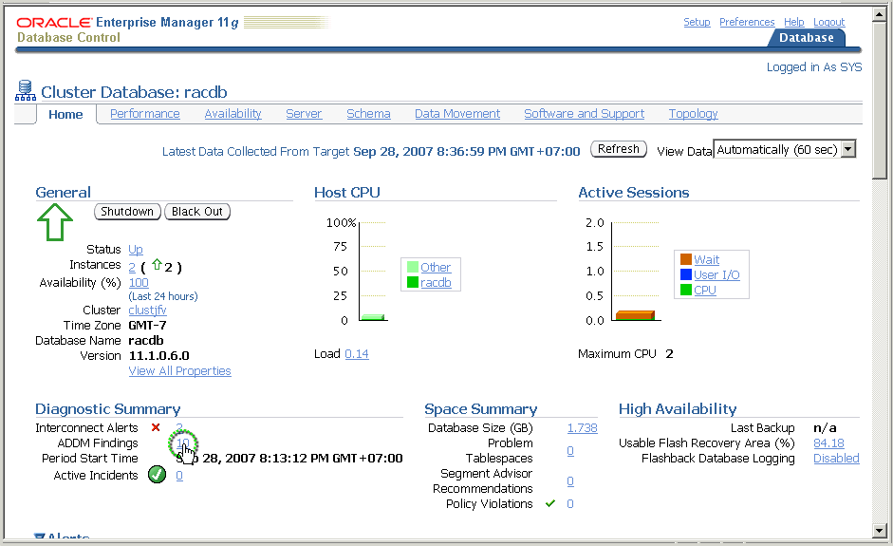
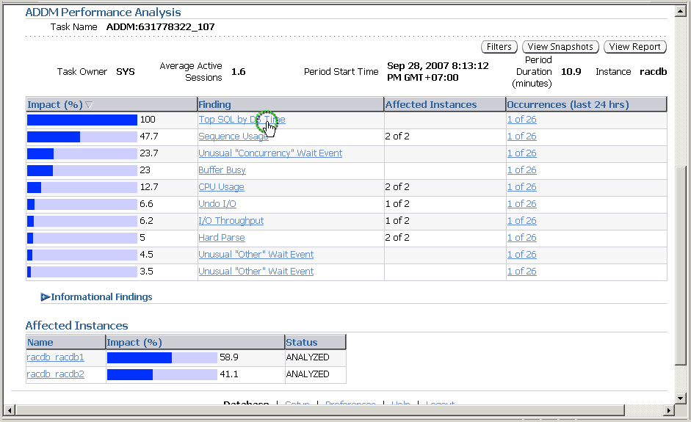
EM Support for ADDM for RAC
Notes:
EM Support for ADDM for RAC
Oracle Database 11g Enterprise Manager displays the ADDM analysis on the Cluster Database home page.
On the Automatic Database Diagnostic Monitor (ADDM) page, the Database Activity chart (not shown here) plots the database activity during the ADDM analysis period. Database activity types are defined in the legend based on its corresponding color in the chart. Each icon below the chart represents a different ADDM task, which in turn corresponds to a pair of individual Oracle Database snapshots saved in the Workload Repository.
In the ADDM Performance Analysis section, the ADDM findings are listed in descending order, from highest impact to least impact. For each finding, the Affected Instances column displays the number (m of n) of instances affected. Drilling down further on the findings takes you to the Performance Findings Detail page. The Informational Findings section lists the areas that do not have a performance impact and are for informational purpose only.
The Affected Instances chart shows how much each instance is impacted by these findings. The display indicates the percentage impact for each instance.

Slide 47
Summary
In this lesson, you should have learned how to:
  Determine RAC-specific tuning components
  Tune instance recovery in RAC
  Determine RAC-specific wait events, global enqueues, and system statistics
  Implement the most common RAC tuning tips
  Use the Cluster Database Performance pages
  Use the Automatic Workload Repository in RAC
  Use Automatic Database Diagnostic Monitor in RAC
Notes:
Oracle Database 11g: RAC Administration 6 - <number>

Slide 48
Practice 6: Overview
This practice covers studying a scalability case by using the ADDM.
Notes:
Oracle Database 11g: RAC Administration 6 - <number>

